Slide 1

An Introduction to World Models
Kiya Aminfar
Sean Steinle

Slide 2
Agenda
Motivating World Models
World Model Components
Using World Models to Dream
Extending World Models to MuJoCo
Q&A

Slide 3

Motivating World Models
Reinforcement Learning, Simulation, and Dreams

Slide 4
What is Sequential Decision Making?
Represented with Markov Decision Processes, solved with Reinforcement Learning
Key Terms
Environment – the entire simulation
Actions – dynamics available to an agent
State – snapshot of the environment at a given timestep
Observations – part of state available to agent
OpenAI/Gymnasium’s Car Racing Environment

Slide 5
The Limitations of Learning in Simulation
Simulations can be expensive
Agents can only learn by doing
Can’t we learn by reflecting or imagining?
Simulations don’t guarantee robust agents
Small changes in environment don’t bother humans, but may derail agents
What if we train the agent in diverse environments?
Google/DeepMind’s MuJoCo Environment
Notes:
After explaining key terms, contrast human knowledge of an environment vs. agentic knowledge. Agents only know things via observations, but humans ostensibly seem to understand the underlying (/generating?) principles of an environment.

Slide 6
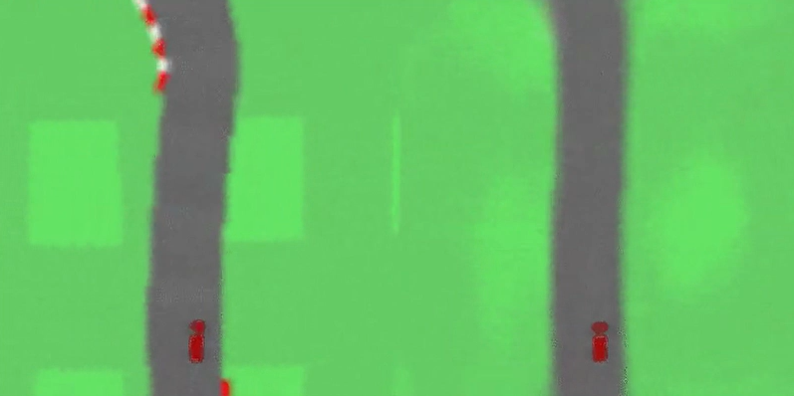
Can Generative Models Help Agents?
Generative models enable training in dreams
Analog to human brainstorming
Agents can master Atari without ever playing
Generative models can guide sampling of high-leverage tasks
Actual CarRacing (left) vs. Dream CarRacing (right)

Slide 7

World Model Components
Understanding Environments by Learning Latent Variables

Slide 8
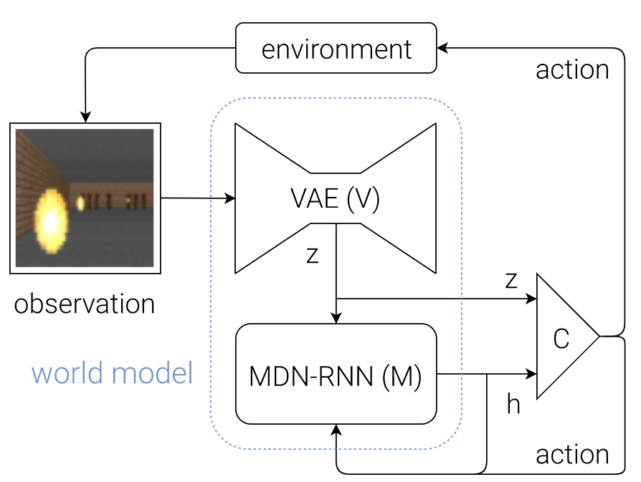
The World Model Architecture
Core Components
VAE (V) – distill observations
MDN-RNN (M) – predict next state
Controller (C) – take action
Because system is complex, original authors implemented simple components
World Model Architecture
Notes:
After explaining key terms, contrast human knowledge of an environment vs. agentic knowledge. Agents only know things via observations, but humans ostensibly seem to understand the underlying (/generating?) principles of an environment.

Slide 9
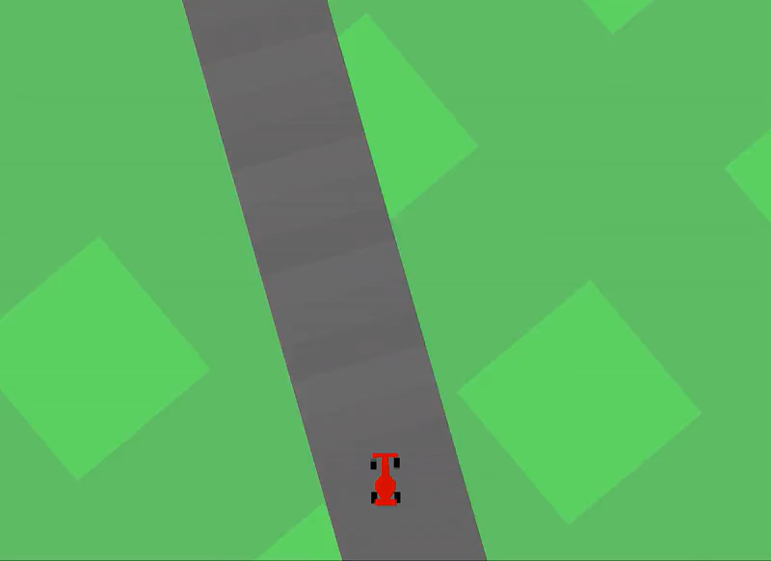
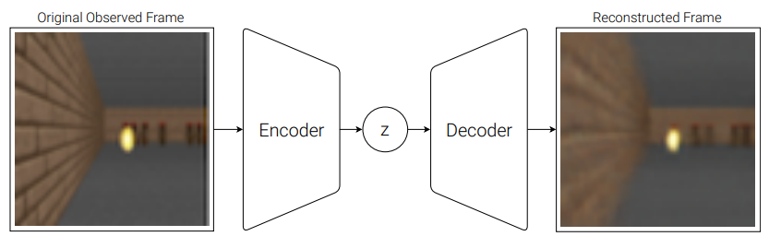
Distilling Observations with a VAE
Goal is to learn key concepts from observations by learning compressed latent space
Implemented as a simple Convolutional VAE
Can train with just VAE and Controller, but policy is erratic
Agent Training with only VAE and Controller
Example of VAE's Function from Doom Environment

Slide 10
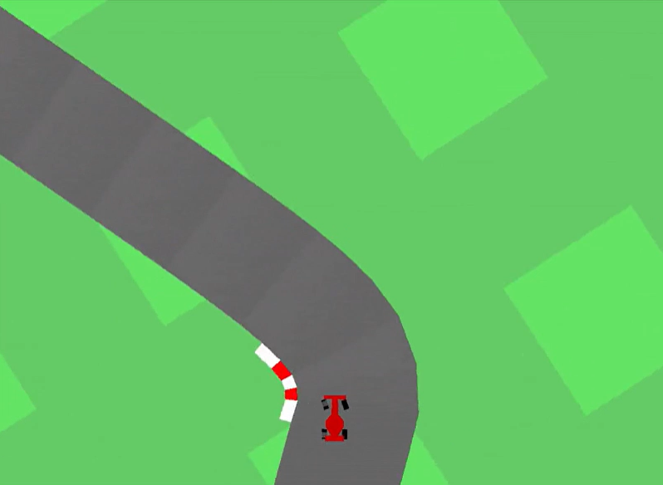
Predicting Next State with an MDN-RNN
Goal is to learn distribution of next states based on latent observations
Model p(z_{t+1}) as mixture of Gaussians, approximate p(z_{t+1} | a_{t}, z_{t}, h_{t}) with RNN
Called the MDN-RNN
Giving the controller access to next state predictions makes for a much smoother policy
Agent Training with VAE, MDN-RNN, and Controller

Slide 11
Choosing Actions with an Evolutionary Controller
Goal is to optimize policy, or action selections over time
Actions are selected based on a simple linear combination of z_{t} and h_{t}
h_{t} is the RNN’s state, represents the next game state
Original paper uses CMA-ES, an evolutionary algorithm to optimize
World Model Architecture
Notes:
NOTE: I know we have this same graphic on slide 8, but people will want to look at it again by this point!

Slide 12
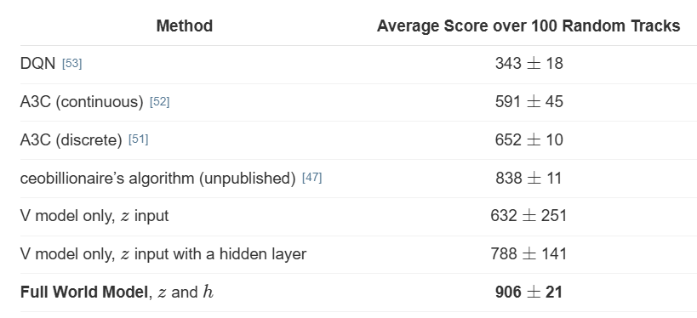
World Models Outperform Traditional RL
Authors surmise that instinctual model of the environment allow for intuitive, reflex-based policies
Performance of Various World Models vs. Traditional RL Methods for CarRacing-v0

Slide 13

Using World Models To Dream
The Architecture of Dreams and Their Performance Benefits

Slide 14
The Architecture of In-Dream Training
Consider that the World Model paradigm approximates each part of an environment:
VAE models observations
MDN-RNN models transitions
Controller models actions
What if we replace the environment with our MDN-RNN?
obs, rew, _, _, _ = step(action)
MDN-RNN
World Model Architecture For In-Dream Training

Slide 15
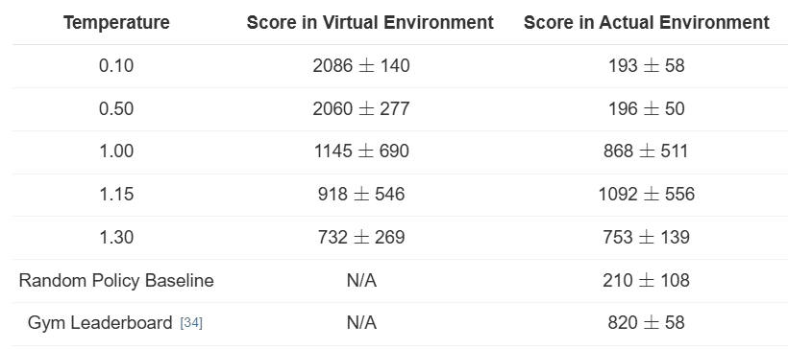
The Goldilocks Zone of Dream Realism
In-dream training allows the agent to control the environment it dreams in
Learning the proper temperature for our dream environment is key
Low temperature => not enough sample diversity
High temperature => unrealistic dreams
In-Dream Training Scores for Doom Environment

Slide 16
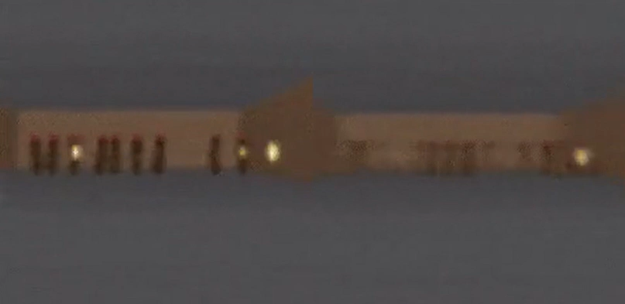
Mastering Doom with In-Dream Training
Environment Reconstructed from VAE
Actual Environment

Slide 17
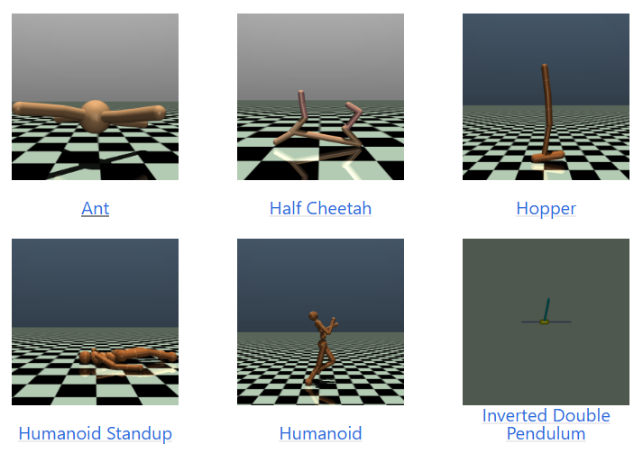
Extending World Models to MuJoCo
A New Environment for World Models

Slide 18

Questions

Slide 19
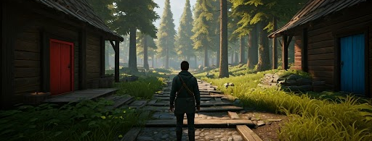
World Models Today
Dreamer, Surfer, and Genie2

Slide 20
Dreamer: Diverse World Models
Google's Dreamer Series Emphasizes Solving Diverse Tasks

Slide 21
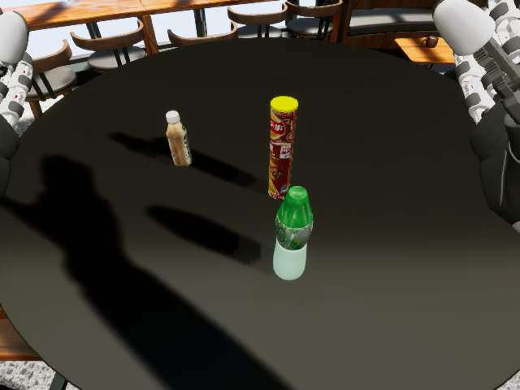
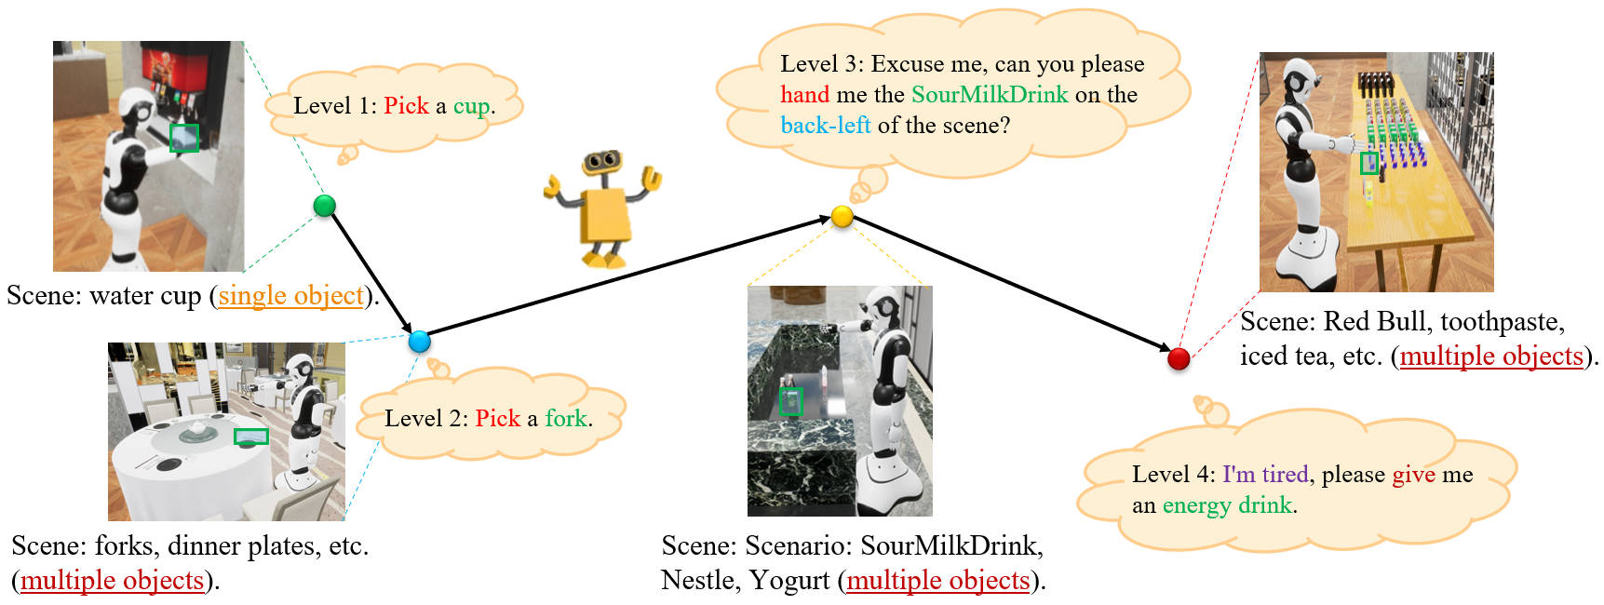
Surfer: Interactive World Models
Surfer Utilizes World Models for Interactivity and Instruction

Slide 22
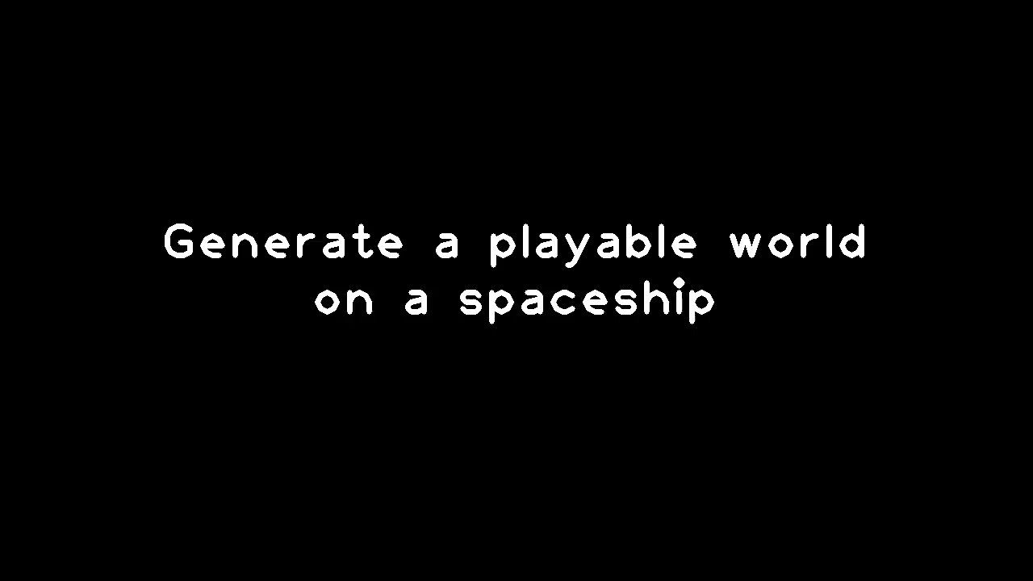
Genie2: World Models for Robust Agents
Google's Genie2 Presents a 'Large-Scale Foundation World Model'

